Slide 1
Deploying an Electronic Health Record Management System with Blockchain: A Proof of Concept Work
Introduction to Blockchain and Bitcoin: CSCI E – 118
Harvard University
Presented by Brian Wagner

Slide 2
The Problem
Currently, health organizations such as hospitals, laboratories, pharmacies and insurers can have multiple and fragmented medical records of patients which can slow or reduce quality of treatment.
Existing electronic health record (EHR) management systems suffer from data manipulation, delayed communication, and trustless cooperation in data collection, storage, and distribution.
For example, a physician can send a patient to a local pharmacy for prescriptions, but the order can be sent to the wrong pharmacy and the pharmacist can’t access the patient’s records to verify the doctor’s order or issue needed medication if there is a problem.
Insurance providers can be slow on verifying coverage due to lacking patient information and many issues result from overhead and lack of communication between parties.
Travelers needing medical assistance may find it difficult for foreign caregivers to have access to their patient records when making decisions for treatment. Doctors need to be able to access medical records of international travelers such as business workers to make better decisions on treatment.

Slide 3
My Solution – A Blockchain Electronic Health Record
Interoperability
  Blockchain could facilitate nationwide interoperability of electronic health records, which would allow providers access to patients’ medical histories, current medications, and prior imaging studies.
  Greater ease of access to records can help patients that are traveling and prevent fragmentation in medical records.
Smart Contracts
  Blockchain can create rule-based protocols where contracts are executed when conditions are met within the code. For example, a patient with health insurance has policy details linked to their profile that are triggered when they seek medical care, ensuring correct payment to providers.
  If patient data were to be stored using a blockchain solution where control, ownership and access to that data were assigned to the patient, it would greatly impact the way companies access and use both identifiable and de-identified patient data.

Slide 4
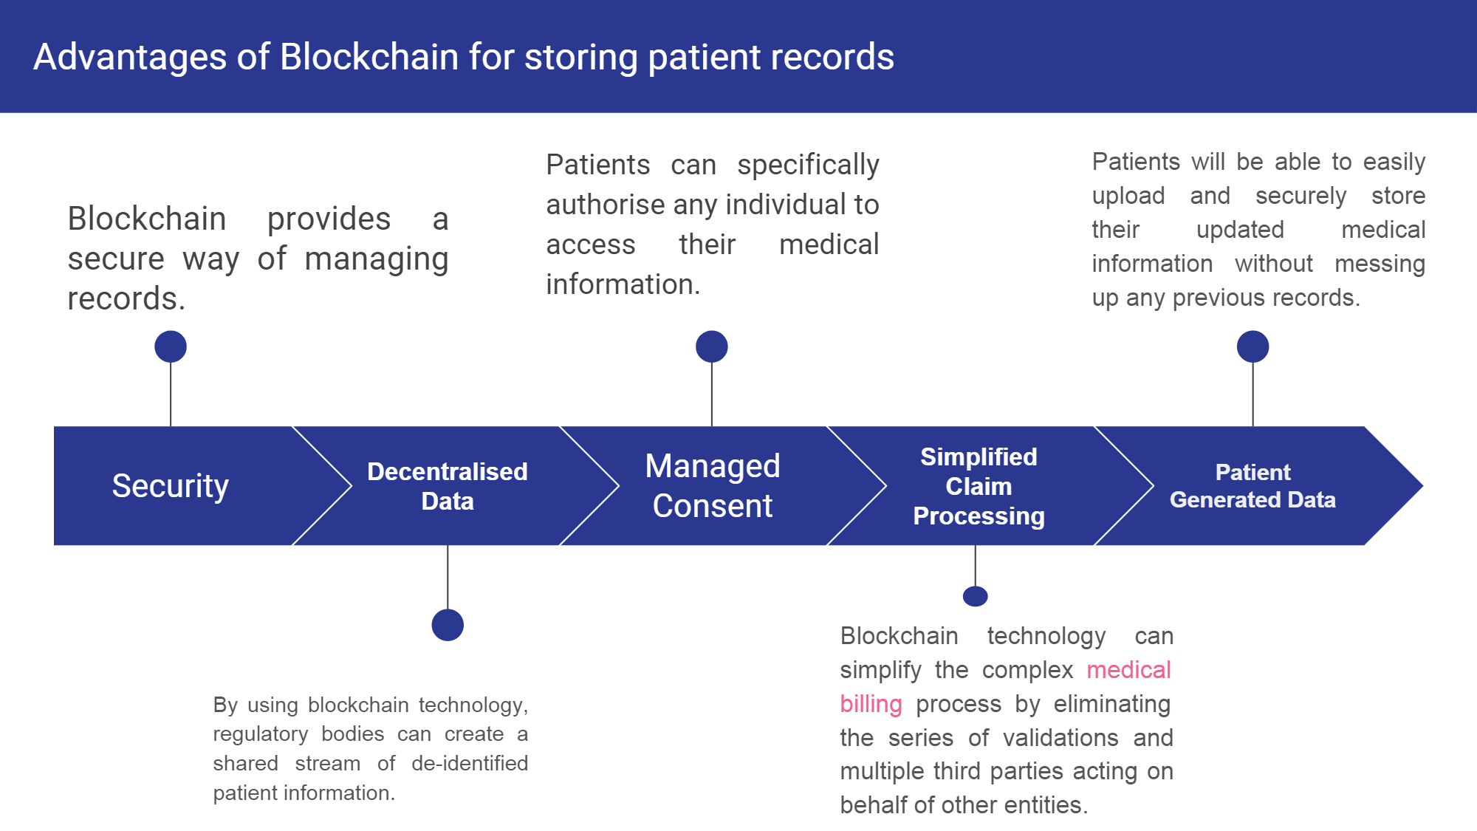

Slide 5
Structure of the Blockchain
Anyone can register on the blockchain as a patient or doctor.
Whenever a patient visits a doctor, the doctor will have the required permissions to store the diagnosis and medical logs in the patient’s record which would be stored in distributed ledgers across the blockchain network.
The medical records of a patient will be accessible from any hospital which is particularly useful for travel and emergency visits to places not in network. Giving this information will assist the medical staff when making decisions on treatment.

Slide 6
Platform
Hyperledger Fabric is an open source blockchain platform. I intend to upload my code so it can be further developed for the benefit of the healthcare industry.
Hyperledger Installation Guide: https://hackernoon.com/hyperledger-fabric-installation-guide-74065855eca9
  Prerequisites
    cURL — latest version
    Docker — version 17.06.2-ce or greater
    Docker Compose — version 1.14.0 or greater
    Golang — version 1.11.x
    Nodejs — version 8.x (other versions are not in support yet)
    NPM — version 5.x
    Python 2.7

Slide 7
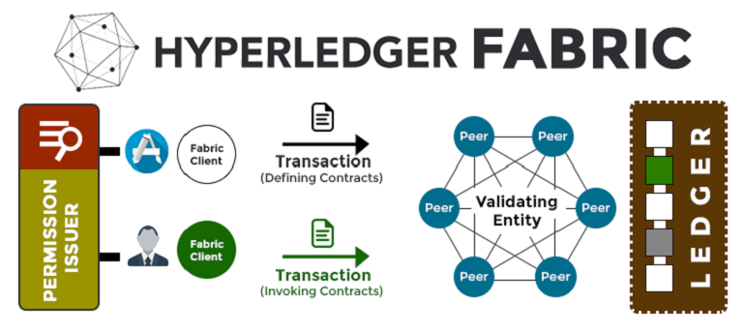
Hyperledger Fabric was my choice for programming because it is a permission blockchain which provides real-time data to only be exchanged on a permitted basis between the network participants. This ensures more safety and security for HIPAA compliance.
The doctor would be required to sign in on the transaction (which would be cryptographically encrypted with his private key) to create and modify the records of a patient (who would be uniquely identified by a patient ID).
https://hackernoon.com/hyperledger-fabric-the-most-popular-hyperledger-framework-b4485dea6a2c

Slide 8
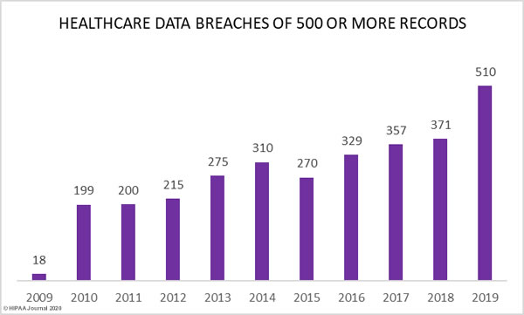
HIPPA Journal
https://www.hipaajournal.com/healthcare-data-breach-statistics/
Data Breaches are a matter of severe importance when programming a decentralized EHR system. In a permissioned based ledger based off cryptic keys, it would be more difficult to breach.

Slide 9
Issues with Safety and Development
Currently, my project is a proof of concept that can be launched as a minimally viable product (MVP), but there are issues that need to be addressed.
I would have to work with administrators and insurers on compliance with existing HIPAA privacy regulations, while keeping the data distributed across the network is an issue with development. Because HIPAA regulations must be followed, administrators need reassurance that the system is secure. This will slow the development and I’d prefer to start small and scale up as the system proves to work.
The last mile problem is the issue over creation of fake patients and properly matching patients with insurance. I intend to code insurance providers and attach them to authorizations. Fake patients and doctors could be created, but transactions require private keys to permit access to records. Also, permissions must be granted to certain individuals for ordering tests. Humans would be able to solve the last mile solution. Having administrative staff that can enter patient records would solve this problem
Data breaches have been occurring for years now. A solution to this problem is to offer time limited access to health records. A smart contract can be launched to give time limited access to a patient’s health record. This would help alleviate potential breaches.
The blockchain system must be improved such that it is eventually impossible to be cryptographically compromised.

Slide 10
Coding and Implementation
Model
  insurance Map is used to store the new patient’s ID along with the amount covered by insurance
  Within this, I entered names of insurance companies and hospitals located within Michigan as an example for intermediaries between the patients and doctors.
  Medicines, tests, and diseases were programmed along with transactions issued between multiple parties including the pathology lab.
Logic
  Appointments are booked and confirmed when a new patient is logged into the system.
  Insurance is checked as well as prescription.
  An async function is programmed to allow the specific prescription to be chosen.

Slide 11
Coding and Implementation
User logic is an example showing the step by step process of interaction between patient, doctor and pathology lab.
Permissions
  Permissions granted are coded for access into the network.
  Only those related to their medical field can be granted access and modify.
  Differences in operation are granted for permission for instance only being able to read, update or create.

Slide 12
In Conclusion
Blockchain has immense potential to improve the field of healthcare by decentralizing and simplifying patient records for permissioned access.
Proof of Concept has been demonstrated through the code and example patient logged in logic as seen when run through Hyperledger Fabric.
Future work can be done by increasing the scale and implementing through a node network at a clinic. Issues including safety and privacy need to be thoroughly explored before large scale to ensure compliance with HIPPA.

Slide 13
References
https://hackernoon.com/hyperledger-fabric-installation-guide-74065855eca9
  Download Hyperledger Fabric Guide
https://hackernoon.com/hyperledger-fabric-the-most-popular-hyperledger-framework-b4485dea6a2c - image
https://www.hipaajournal.com/healthcare-data-breach-statistics/ - chart

